Slide 1




FILE ZIPPER PROJECT
Project By:
BALAKUMAR GUHESH 3122215002019
BHARATH KUMAR G 3122215002020
BHUVANESWARRAN T 3122215002021
DARRIEN XAVIER P V 3122215002022
DEEPESH SUDHAN A 3122215002023
DENNIS ANDREW B 3122215002024

Slide 2

MOTIVATION
The motivation behind the File Zipper project is to address the growing need for efficient file compression solutions in today's digital landscape. There are several key motivations driving the development of this project:
1. Data Storage Optimization: With the ever-increasing amount of digital data being generated, effective storage optimization is crucial.
2. File Transfer Efficiency: Compressed files take up less space, resulting in faster and more efficient file transfers.
3. Bandwidth Conservation: In environments with limited bandwidth, such as low-speed internet connections or mobile networks, file compression becomes essential to conserve bandwidth.
4. Improved User Experience: By reducing file sizes, file compression enhances user experience by enabling faster loading times for web pages, applications, and multimedia content.
5. File Archiving and Backup: Compressed files are ideal for long-term archiving and backup purposes.

Slide 3
PROBLEM STATEMENT- File Zipper
Develop an online application for a File Zipper Project. The application should have the following functionalities:
Compression and Decompression: The application should be able to compress input files using Huffman encoding and decompress the Huffman-coded files back to their original form.
Maximum file size check: The application should check if the input file size exceeds a predefined maximum size limit. If the file size exceeds the limit, the application should show alert boxes notifying the user about the size limit.
Multiple file compression: If the user inputs more than one file, the application should merge the contents of all the input files into a single file and then perform compression on the merged file.

Slide 4
PROJECT SCOPE AND LIMITATIONS
Scope:
To be able to provide higher compression ratio for any given file size without any data loss. To provide a modern and friendly user-interface, and handle errors if any. The main scope of our project is to provide high performance and fast processing of files.
Limitations:
Large File Size: While Huffman Coding technique ensures good compression ratios, for file size exceeding 20 MB the time taken for compression will drastically increase. Other compression algorithms can achieve higher efficiencies.
Security: While compressed files can be password-protected, the project may not provide encryption or other security features, depending on the project's requirements and scope
Lack of Symbol Diversity: Unlike text data, which has a wide range of distinct symbols, image data primarily consists of a large number of color values or grayscale levels..
Pixel Relationships: Images often contain spatial and contextual information, where the values of neighboring pixels are correlated

Slide 5
ALGORITHM
Frequency Analysis: The first step in Huffman coding is to perform a frequency analysis on the input data. This involves counting the occurrence of each symbol in the data, such as characters in a text file or pixels in an image.
Symbol Encoding: Next, each symbol is assigned a code based on its frequency. Symbols that occur more frequently are assigned shorter codes, while symbols that occur less frequently are assigned longer codes.
Huffman Tree Construction: A Huffman tree is then constructed based on the assigned codes. This is a binary tree where each leaf node represents a symbol, and the path from the root to the leaf represents the code for that symbol.
Encoding: The input data is then encoded using the Huffman tree. Each symbol in the input data is replaced with its corresponding code from the Huffman tree. The resulting encoded data is typically much smaller than the original data, as the most common symbols are assigned shorter codes.
Compression: The encoded data is then compressed by writing it to a compressed file format, such as ZIP. The compressed file contains the Huffman tree and the encoded data.
Decompression: To decompress the data, the Huffman tree is first reconstructed from the compressed file. The encoded data is then decoded using the Huffman tree, replacing each code with its corresponding symbol.

Slide 6


Tools used:
HTML
CSS
Node.js
Javascript Embedded JavaScript
Express.js
Data-Structure Used:
Priority Queue (using Minheap)
Binary Tree

Slide 7
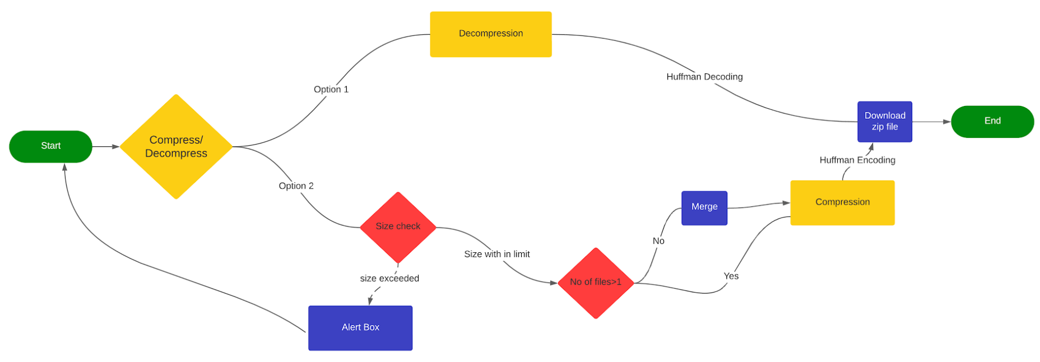
PROCESS FLOW

Slide 8
IMPLEMENTATION
Huffman coding technique was implemented for compression and decompression.
After analyzing other algorithms Huffman algorithm was chosen due to its faster approach and efficient memory usage.
A user-friendly innovative user interface has been developed as a primary
objective. Documentation and help are being included in the interface to guide
people on how to work on the application.
Huffman coding efficiently compresses the input file and maintains accuracy. It is a lossless compression algorithm which assigns variable length code to input characters in case of text data.
The two main major parts in Huffman Coding:
Build a Huffman Tree from input characters in the file.
Traverse the Huffman tree and assign codes to characters appropriately.

Slide 9
Implement a file upload mechanism that allows users to select and upload files.Validate the file size before compression, and if it exceeds the maximum size, display an alert box informing the user about the limitation.
If the user selects multiple files, we implemented a file merging functionality. Combine the contents of the selected files into a single before performing compression.
Implement the reverse process to decompress the Huffman-coded file back to its original format. Reconstruct the original file by replacing the Huffman codes with their corresponding symbols.

Slide 10
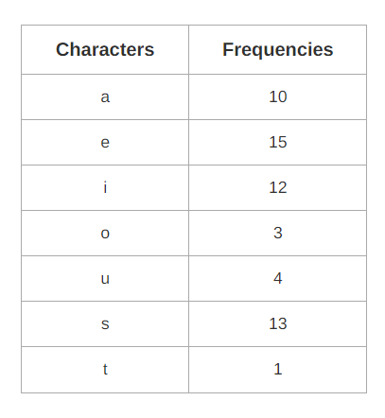
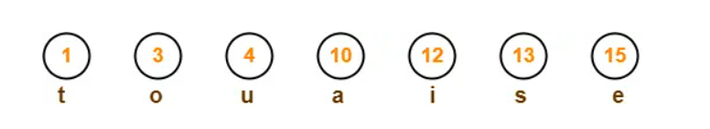
PROPOSED METHODOLOGY

Slide 11
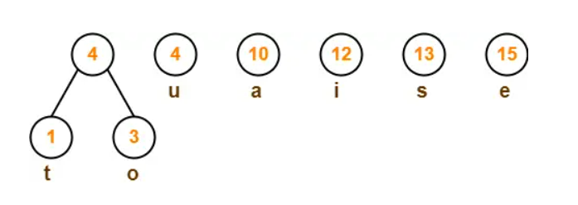
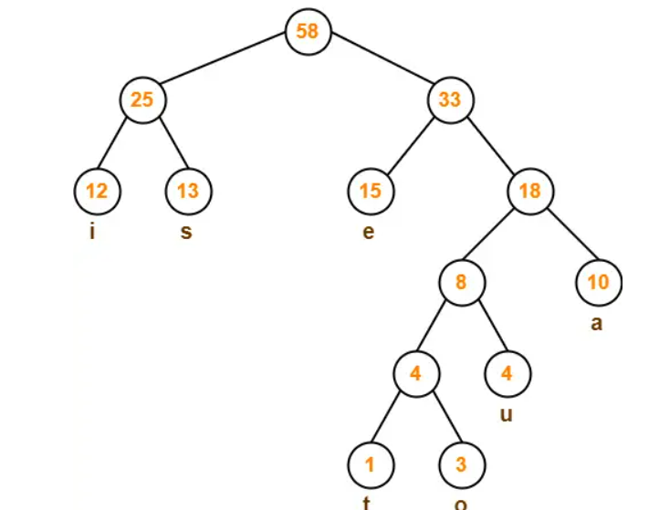

Slide 12
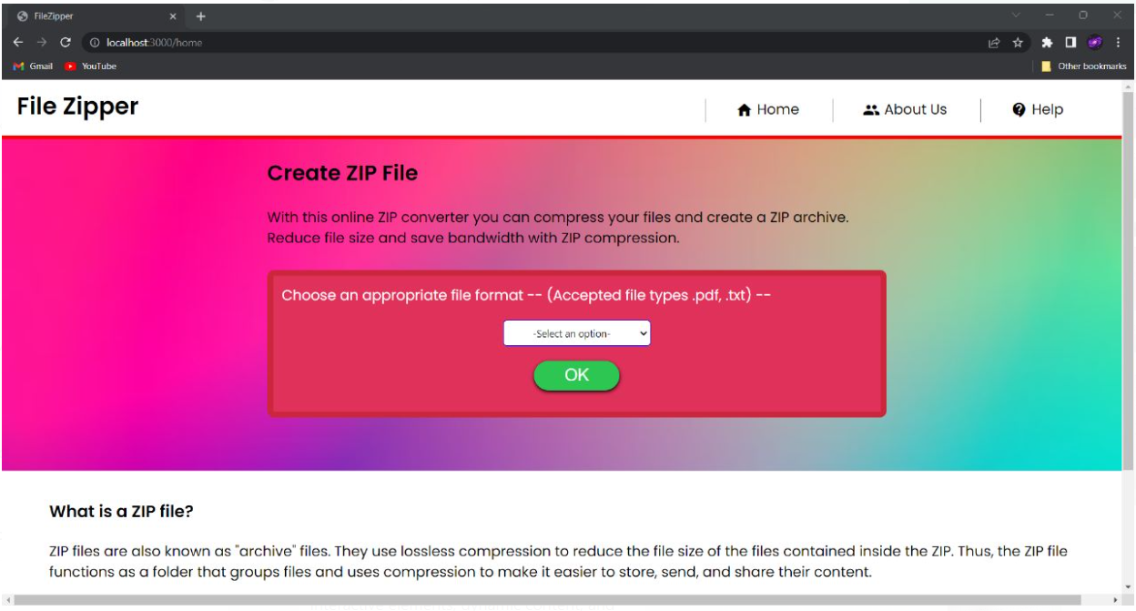
Expected UI-Design (Uploading input files to application)

Slide 13
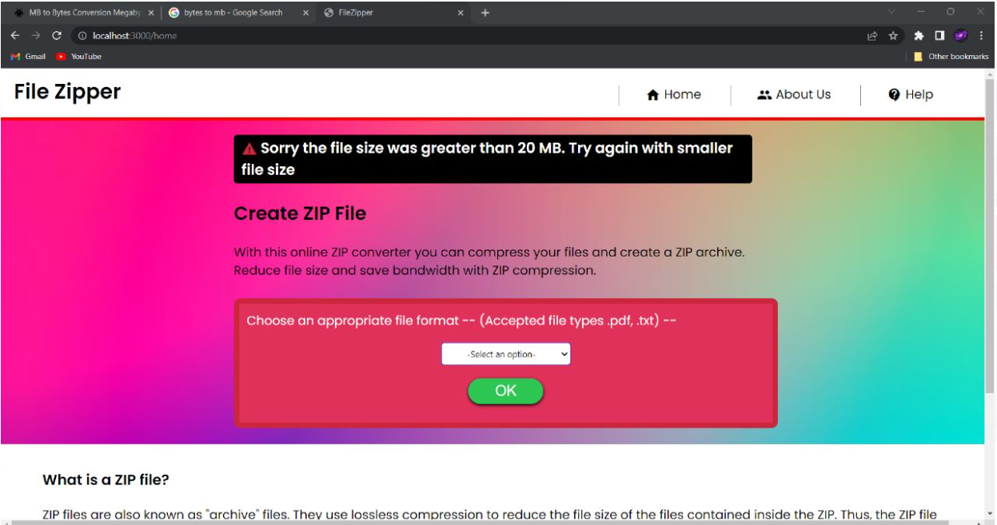
Expected UI-Design (Alert Generation)

Slide 14
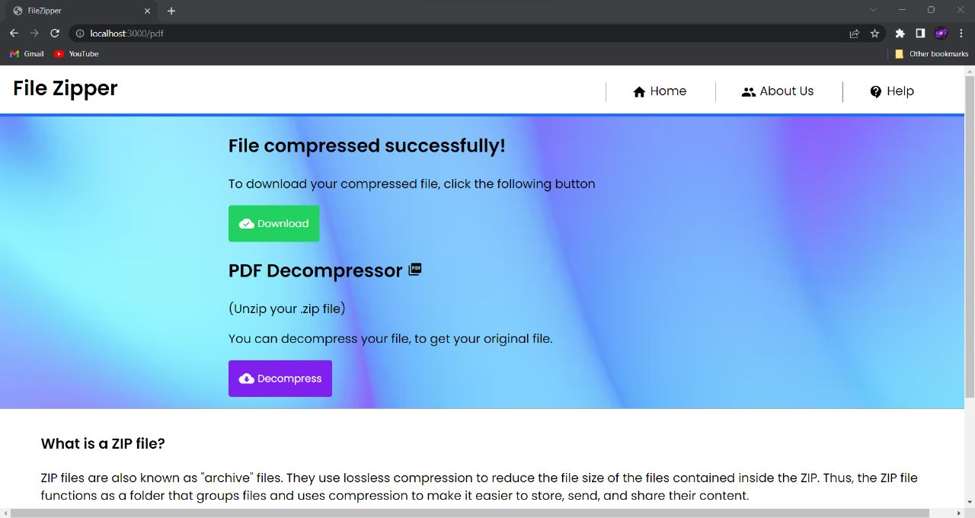

Slide 15
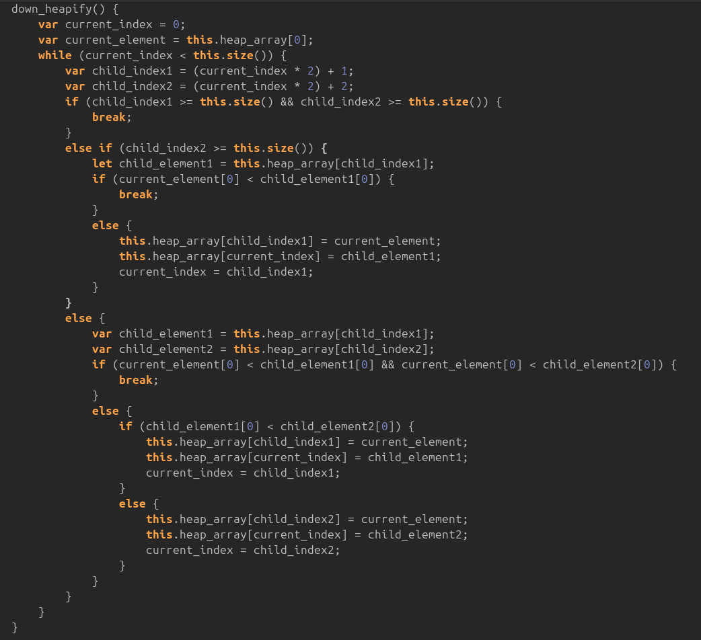
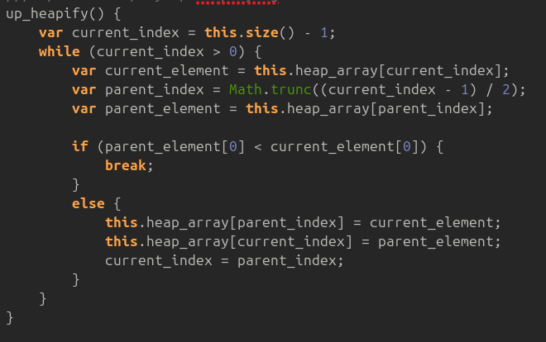
Code Snippet (Implementation of Priority Queue)

Slide 16
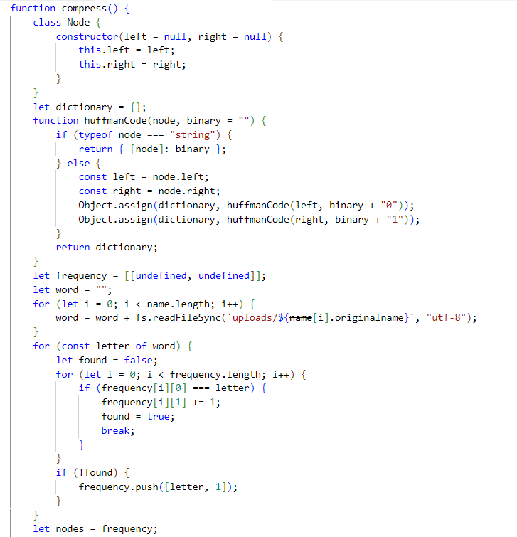
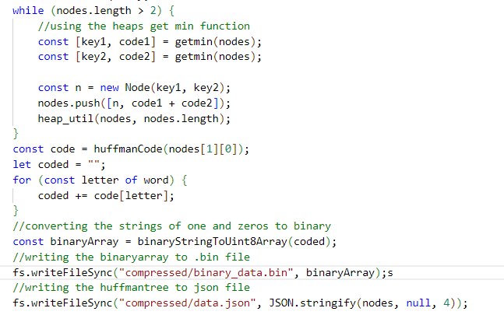
Code Snippet - (Compression)

Slide 17
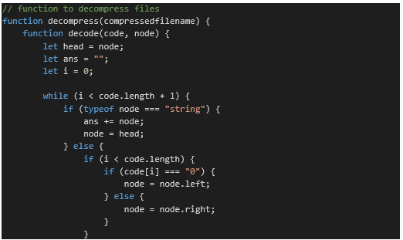
Code Snippet-(Decompression)

Slide 18
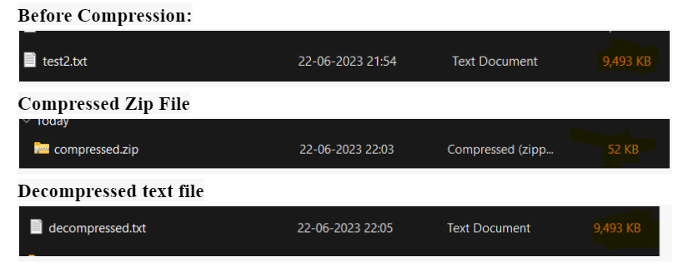
Expected Outcome
Performance and efficiency of the project was then analyzed through testing.

Slide 19
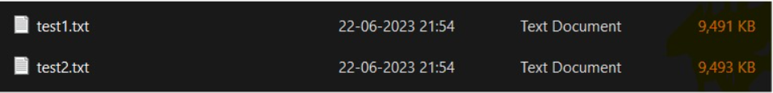
Expected UI Design (File Merging)
Before Compression
After Compression

Slide 20
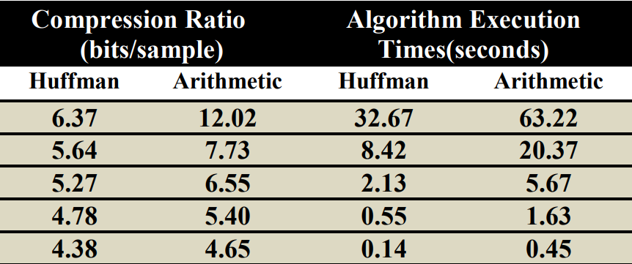
Expected Outcome-Algorithm Efficiency
The compression ratio is obtained by taking the ratio of compressed file size to original file size.
Huffman coding can achieve compression ratios in the range of 20-50% for text-based data, such as English language text.
However, the actual average compression ratio can vary widely depending on the characteristics of the data being compressed.

Slide 21
Literature Survey
The available algorithms for compression include:
Lempel-Ziv-Welch: A popular compression algorithm for text data which involves a dictionary to store frequently occurring words in shorter codes, the algorithm builds a dictionary of patterns from the text encountered.
Run-Length Encoding: This algorithm is suitable for text compression that contains long sequences of repeated characters. It replaces long occurrences of a specific character by its count and the character itself. If the text has repeated patterns then this algorithm could be used.
Arithmetic coding : This algorithm converts the entire text into a fractional number within a specified range. It operates on sequence of characters rather than individual characters. This algorithm is most efficient but computation is quite complex.
We have chosen Huffman coding since it is relatively faster and it is a lightweight algorithm in terms of memory usage and computational requirements.

Slide 22
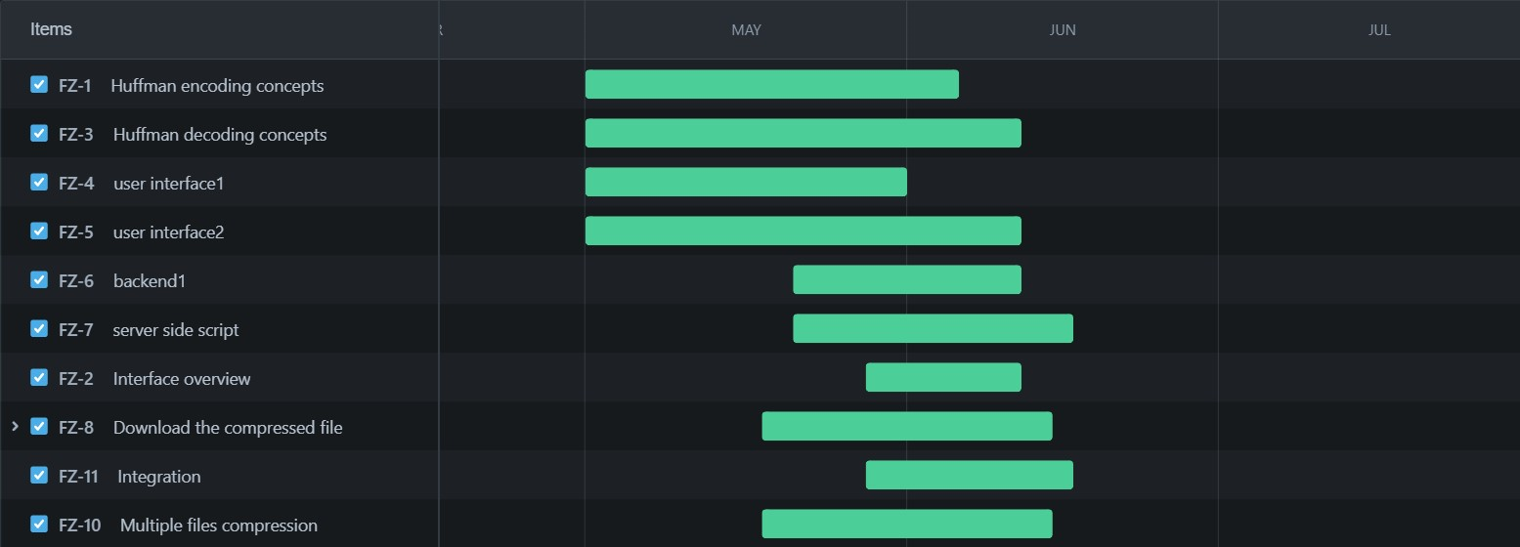
Project Management
Agile project management is an iterative and flexible approach to project management that focuses on collaboration, adaptability, and delivering value to the customer. It emphasizes frequent feedback, continuous improvement, and the ability to respond to changes quickly.
TIMING DIAGRAM

Slide 23
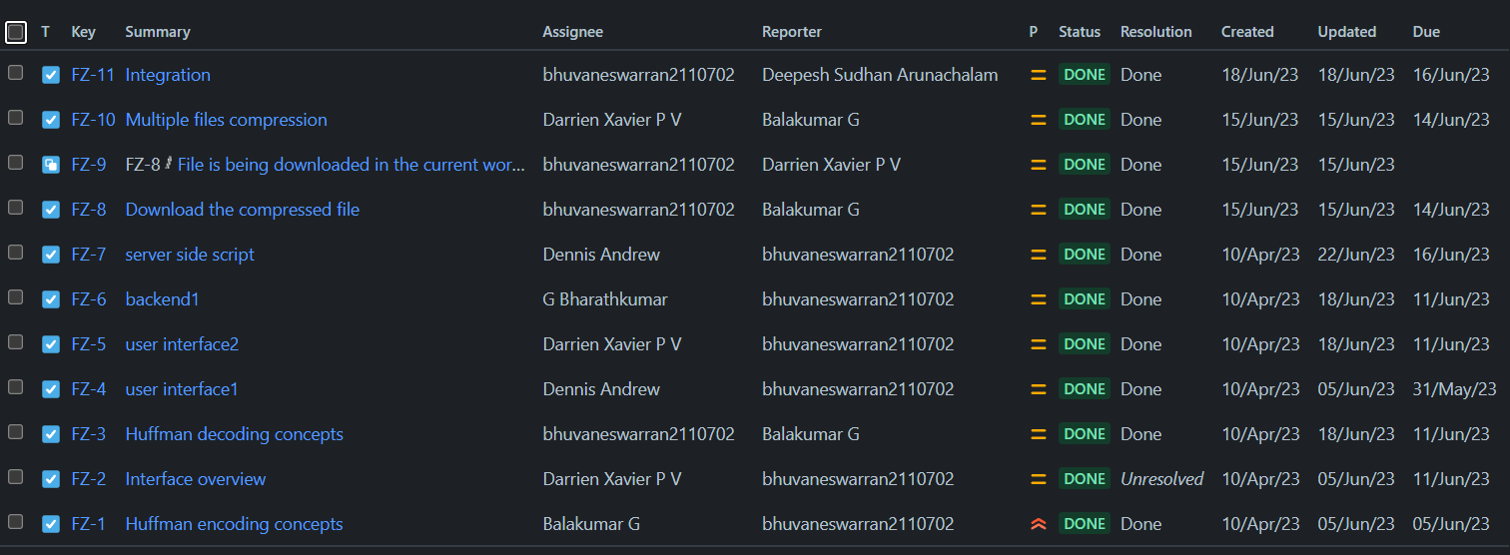

Slide 24
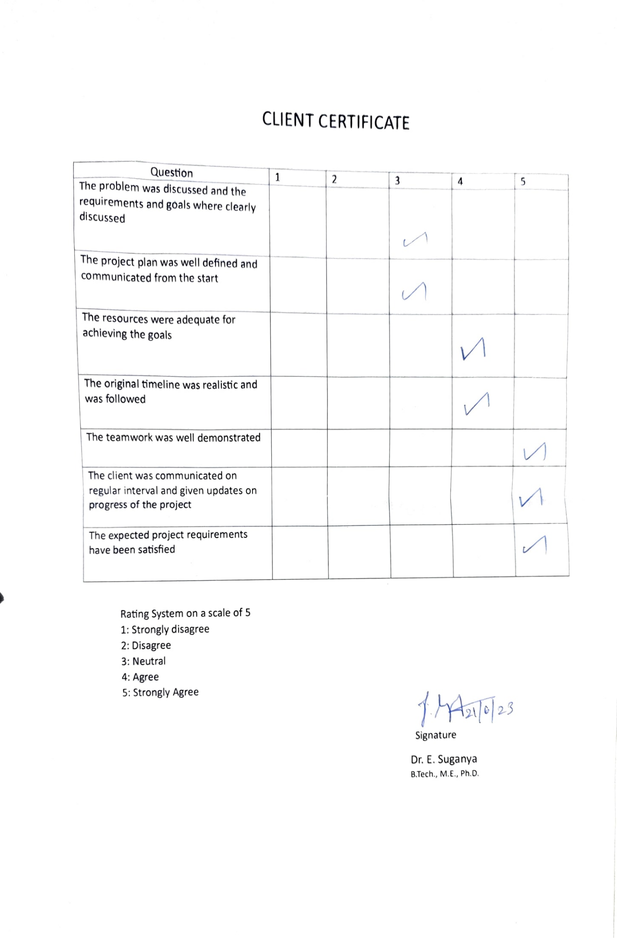

Slide 25
References
https://www.geeksforgeeks.org/text-file-compression-and-decompression-using-huffman-coding/
https://dennis-andrew.atlassian.net/jira/core/projects/FZ/board
https://github.com/Bala040404/Filezipper
https://www.w3schools.com/nodejs/

Slide 26
THANK YOU

